Slide 1
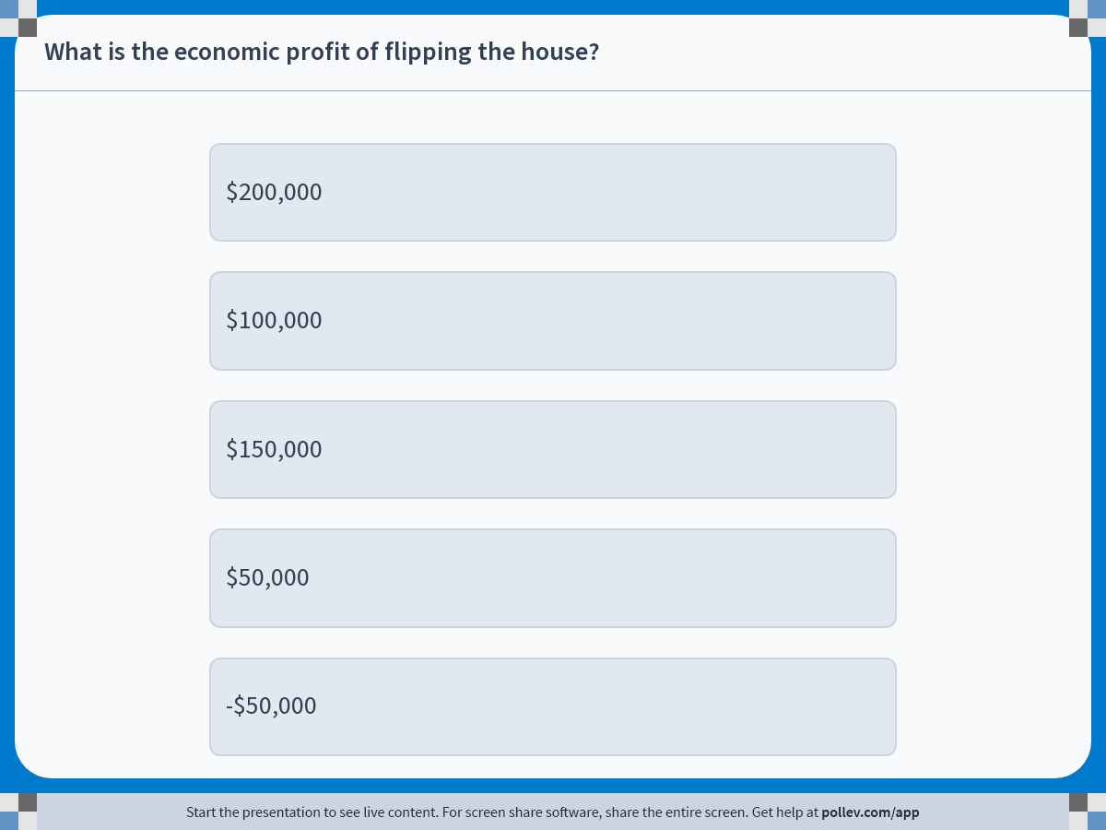
Notes:
Poll Title: Do not modify the notes in this section to avoid tampering with the Poll Everywhere activity. More info at polleverywhere.com/support What is the economic profit of flipping the house? https://www.polleverywhere.com/multiple_choice_polls/jgN2yjFR118rTG1t1KiMN?display_state=instructions&activity_state=opened&state=opened&flow=Instructor&onscreen=persist

